Slide 1
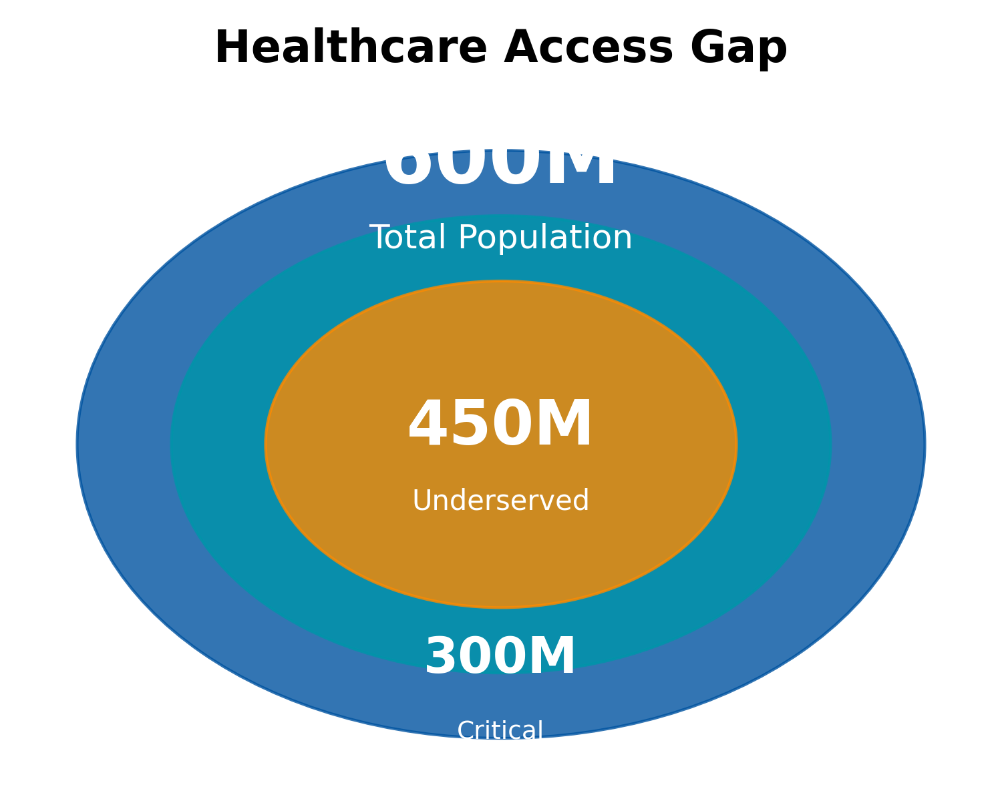
Tier 2/3 India: The Untapped Healthcare Goldmine
🏥
Doctor Availability
1 doctor per 11,000 people (vs 1:1,000 in cities)
🚗
Distance Barrier
Avg 47km to nearest hospital, 3+ hours travel
💰
Affordability Crisis
60% earn <₹10,000/month, 85% lack insurance
📱
Digital Readiness
67% own smartphones, 4G coverage expanding
Healthcare gap in Tier 2/3 cities represents India's largest underserved market opportunity
1

Slide 2
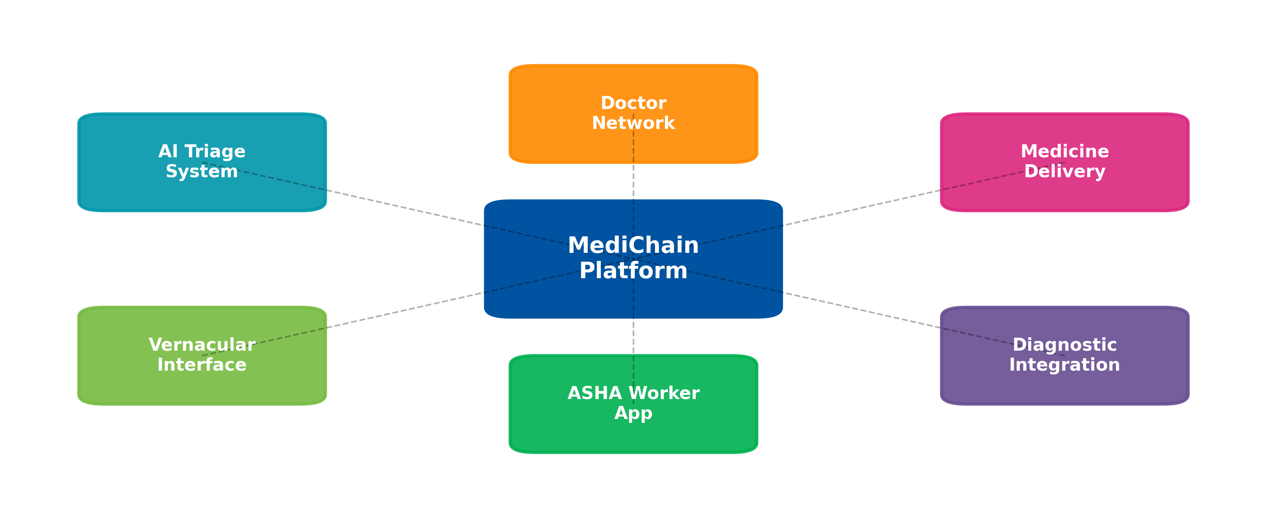

MediChain: AI-Powered Healthcare Ecosystem for Bharat
Competitive Positioning
Patient Journey & Conversion
 | Urban | Rural
Broad | Practo, 1mg | Gap: Vernacular + Low-cost
Narrow | PharmEasy | Gap: Trust + ASHA
MediChain's integrated approach addresses every barrier in rural healthcare delivery
2

Slide 3
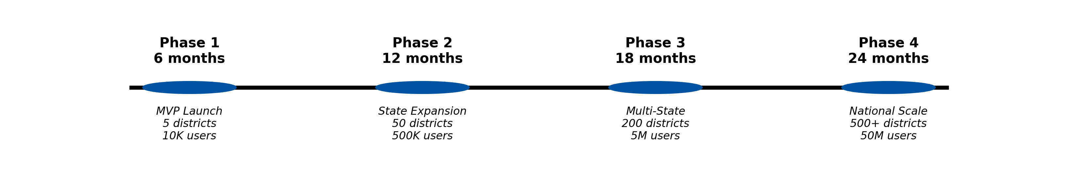
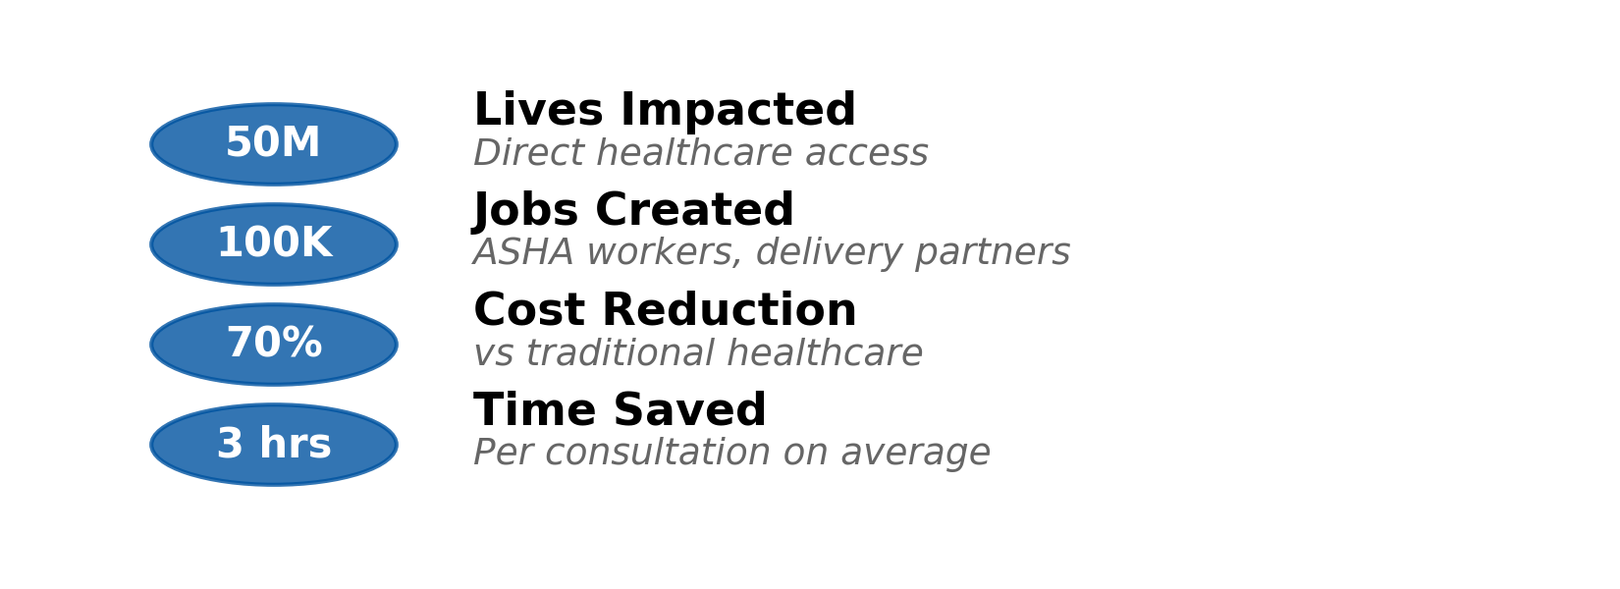
Path to ₹5,000 Cr: Scale, Impact & Returns
Financial Projections (Year 5)
Social Impact by Year 5
Revenue ₹5,000 Cr
EBITDA Margin 22%
Break-even Month 30
Funding Need ₹500 Cr
MediChain: Transforming rural healthcare while building a sustainable, profitable business
3

